Slide 1
Git and GitHub Introduction
Mohamed Agami

Slide 2
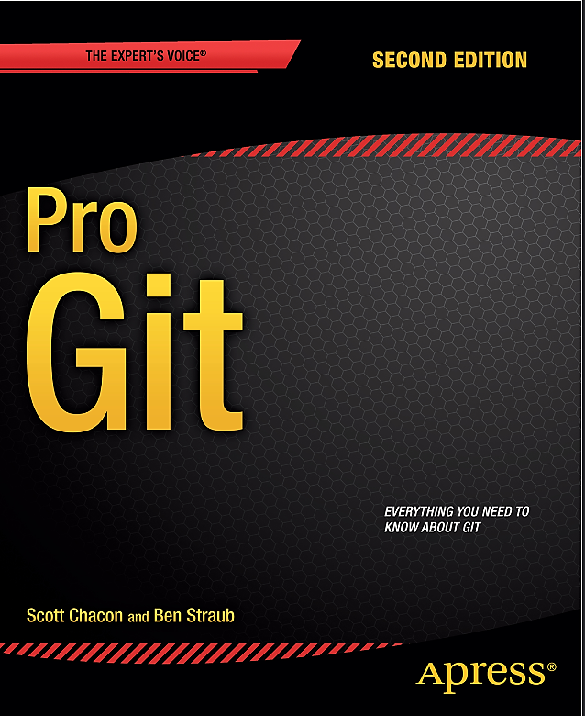
Reference
Pro Git book form here
W3schools from here
My personal experience

Slide 3
What is version control
Version control is a system that records changes to files over time, allowing you to track revisions and collaborate with others. Here are the main features and benefits of version control:

Slide 4
Types of VCS (Version Control System)
Local Version Control System
Centralized Version Control System
Distributed Version Control System

Slide 5
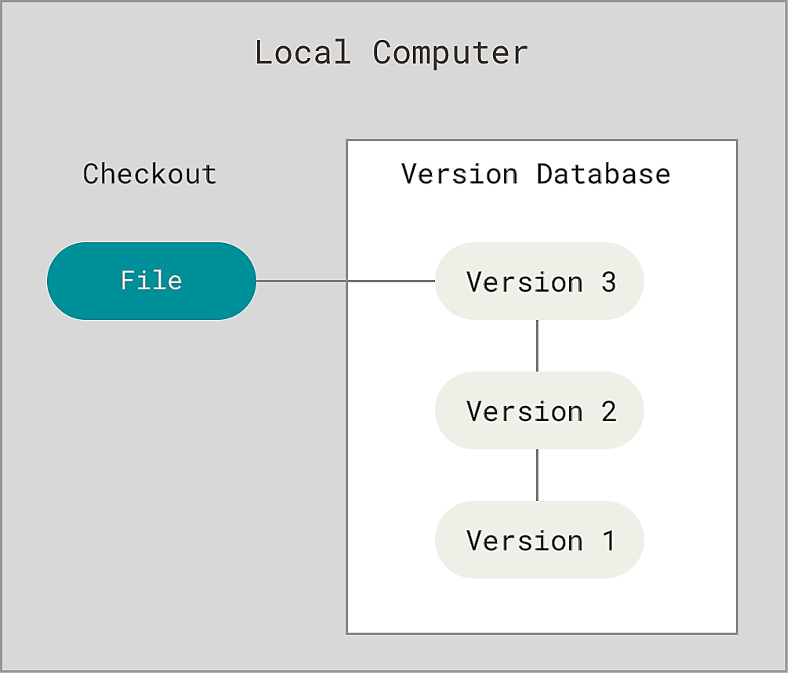
Local Version Control System
A local version control system stores file changes as patches on your computer, allowing you to view the file's state by aggregating relevant patches.
The first local version control system SCCS (Source Code Control System)
was created at Bell Labs in 1972 for UNIX. RCS followed in 1982 as the first cross-platform system, though both served single users and focused on text files.

Slide 6
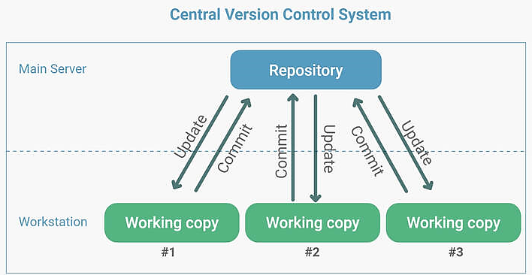
Centralized Version Control System
A centralized version control system features a single server with all file versions, allowing multiple clients to access, pull, or push files while enabling administrators to control user permissions.
History of Central VCS: Centralized Version Control began development in 1986. The Concurrent Versions System, known as CVS, was the first system to feature a central repository and be accessible to multiple user

Slide 7
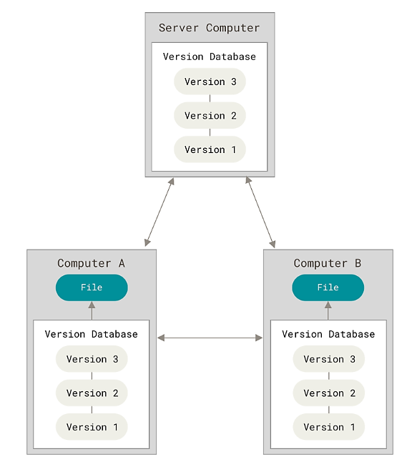
Distributed Version Control System:
A distributed version control system allows each user to have a complete copy of the repository, enabling offline work, independent branching, and merging. It enhances collaboration and version tracking across multiple users and locations. Examples include Git and Mercurial

Slide 8
A Short History of Git
Git's origin is rooted in controversy during the development of the Linux kernel, an expansive open-source project. From 1991 to 2002, software changes were shared as patches. In 2002, the project adopted BitKeeper, a proprietary distributed version control system. However, in 2005, the relationship with BitKeeper soured, leading to the revocation of its free status. This prompted Linus Torvalds and the Linux community to create Git, incorporating lessons learned from BitKeeper. Key goals for Git included speed, a simple design, robust support for non-linear development, a fully distributed architecture, and efficient handling of large projects like the Linux kernel.
Since its birth in 2005, Git has evolved and matured to be easy to use and yet retain these initial qualities. It’s amazingly fast, it’s very efficient with large projects, and it has an incredible branching system for non-linear development

Slide 9
Snapshots, Not Differences
The key distinction between Git and other version control systems (like Subversion) lies in how they manage data. While most systems track changes as a list of modifications to files over time (known as delta-based version control), Git views its data as snapshots. This means Git saves the entire state of a project at each point in time, rather than just the changes made, making it more efficient and easier to work with.

Slide 10
Version 1
Version 2
Version 3
Version 4
Version 5
File A
∆1
∆2
File B
∆1
∆2
File C
∆1
∆2
∆3
Version 1
Version 2
Version 3
Version 4
Version 5
File A
A1
A1
A2
A2
File B
B
B
B1
B2
File C
C1
C2
C2
C3

Slide 11
What is Git?
Git is a popular version control system. It was created by Linus Torvalds in 2005 and has been maintained by Junio Hamano since then.
It is used for:
Tracking code changes
Tracking who made changes
Coding collaboration

Slide 12






What does Git do?
Manage projects with Repositories
Clone a project to work on a local copy
Control and track changes with Staging and Committing
Branch and Merge to allow for work on different parts and versions of a project
Pull the latest version of the project to a local copy
Push local updates to the main project

Slide 13
Why git?
More than 70% of developers use Git!
Developers can work together from anywhere in the world.
Developers can see the complete history of the project.
Developers can revert to previous versions of the project.

Slide 14

Git architecture

Slide 15



Working directory
repository
tree
version1
version2
version3
blob
File.git
content
content
Meta data
Meta data
Agmai.txt
Agmai.txt
Agmai.txt
Agmai.txt
commit
Tagged annotation
Track everything
OS independent
Unique ID
Track History
✅
Echo “my name is Mohamed”
Echo “my name is Mohamed” | shasum
✅
✅
✅

Slide 16
Working directory
repository

Slide 17



Working directory
Staging area
.git directory
(repository)
Git init
Git add
Git commit
untraced
traced

Slide 18

Install git from here

Slide 19
Using Git with Command Line
git --version
git config --global user.name “Muhammad Agami"
git config --global user.email “mohamedagami596@gamil.com”
mkdir myproject
cd myproject
git init

Slide 20
Working directory
Staging area
.git directory
(repository)
Git init
Rm -rf .git
Git status
Git status -s
Git restore file.txt
Git diff
Git status
Git status -s
Git ls-files
Git rm –cached file.txt
Git restore –staged file.txt
Git diff --staged
Git log
Find .git/objects/ -type f
Git log –oneline
Git reflog
Git reset rw878
Git show rw878
Git commit --amend –m “”
Git reset --hard HEAD~1
Git reset --hard HEAD@{1}
Git tag –a V1.0 –m “version1”
Git show v1.0
Git add
Git commit

Slide 21
Git Adding New Files
echo “my name is Mohamed” >> file.txt
ls
git status
readme.md
git rm –cached file.txt
git add –all
git reset head file.txt
Git ls-files

Slide 22
Git Commit
git commit -m "First release of Hello World!“
git status –short
?? - Untracked files
A - Files added to stage
M - Modified files
D - Deleted files
git commit -a -m "Updated index.html with a new line“
git log

Slide 23
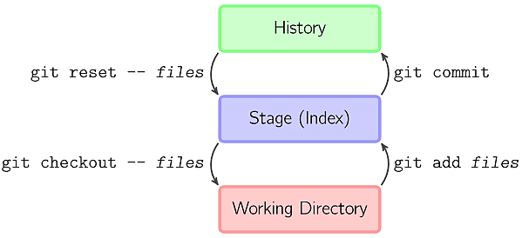
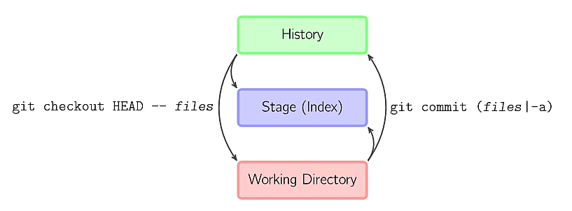

Slide 24
Git Help
git commit –help
git help --all

Slide 25

Git Branch (Working with Git Branches)

Slide 26
HEAD
HEAD
HEAD
Merge
master
master
master
m7n2z
a3b9x
f5t6p
k1v3y
s8l0q
d4h2c
w3r7b
test
test
HEAD

Slide 27
Git Branch
git branch hello-world-images
git branch
git checkout hello-world-images
git checkout -b emergency-fix

Slide 28
Git Branch Merge
git checkout master
git merge emergency-fix
git branch -d emergency-fix

Slide 29
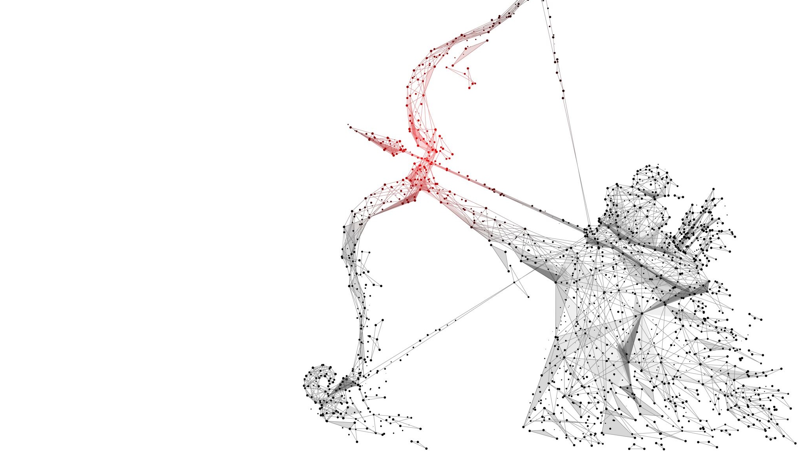
Git GitHub

Slide 30
What is GitHub?
Git is not the same as GitHub.
GitHub makes tools that use Git.
GitHub is the largest host of source code in the world and has been owned by Microsoft since 2018.
we will focus on using Git with GitHub.

Slide 31




Git hub
Ownership: Owned by Microsoft.
Date Established: 2008.
Market Share: Approximately 50-60% of the market.
Git lab
Ownership: Owned by GitLab Inc
Date Established: 2011.
Market Share: Approximately 20-30% of the market.
Bitbucket
Ownership: Owned by Atlassian.
Date Established: 2008.
Market Share: Approximately 10-15% of the market.
SourceForge
Ownership: Owned by Slashdot Media..
Date Established: 1991.
Market Share: Approximately 5-10% of the market.

Slide 32
GitHub Install
You can download GitHub for free from the following website from here

Slide 33

GitHub Account

Slide 34
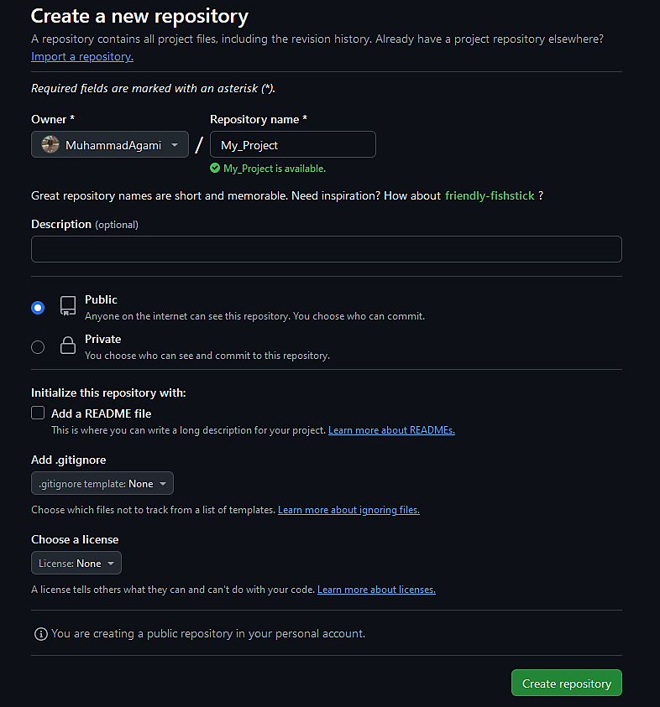
Create a Repository on GitHub

Slide 35
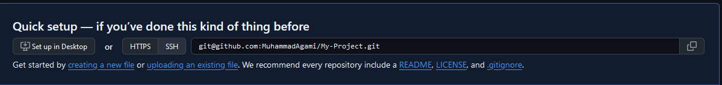
git remote add origin git@github.com:MuhammadAgami/My-Project.git
git branch -M main
git push -u origin main

Slide 36
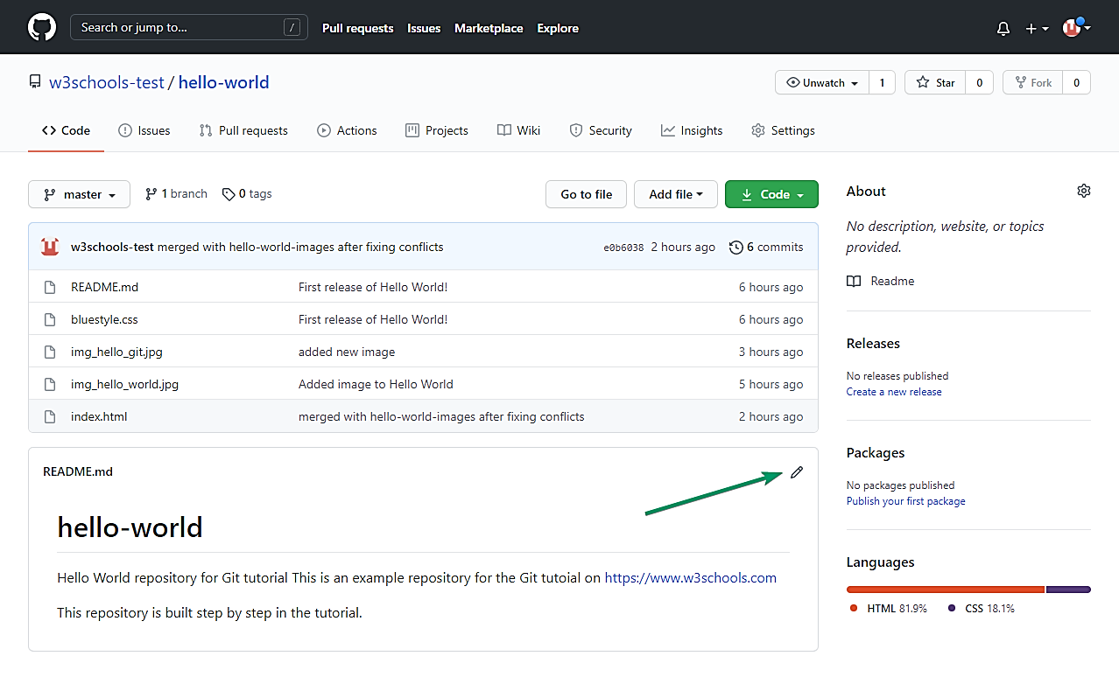
Git GitHub Edit Code

Slide 37
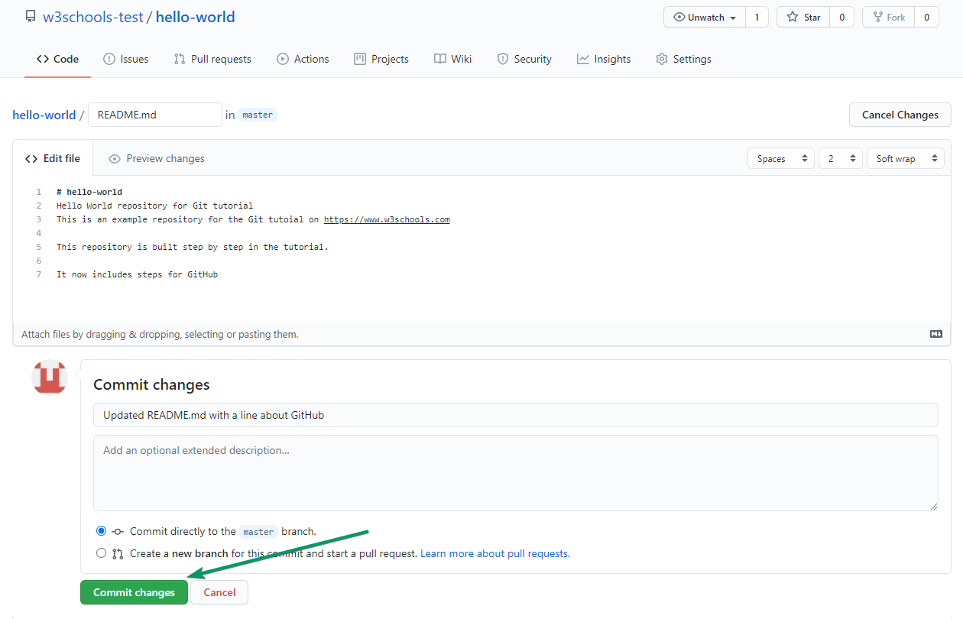

Slide 38
Git Pull from GitHub
git fetch origin
git status
git log origin/master
git diff origin/master
git merge origin/master
git status
Git pull origin

Slide 39
Git Push to GitHub
git commit -a -m "Updated index.html. Resized image“
Git branch –m main
git push origin master

Slide 40

Git GitHub Branch
Create a New Branch on GitHub
Git Pull Branch from GitHub (git branch –(r & a))
Push a Branch to GitHub
Git GitHub Pages

Slide 41

GitHub fork

Slide 42
Clone a Fork from GitHub
git clone https://github.com/w3schools-test/w3schools-test.github.io.git
git remote –v
git remote rename origin upstream

Slide 43
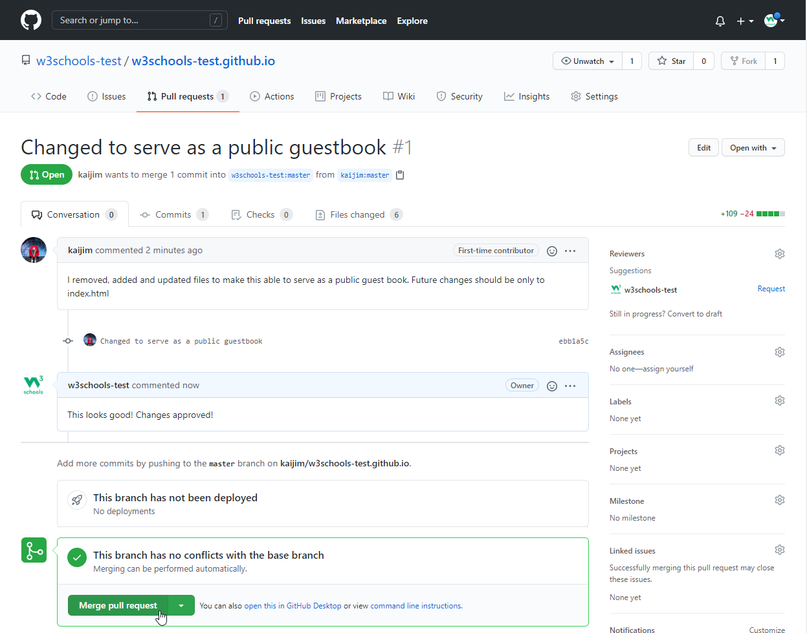
Push Changes to Our GitHub Fork
git push origin

Slide 44
Git Security SSH
ssh-keygen -t rsa -b 4096 -C „mohamedagami596@gmail.com„
Cat ~/.ssh/id_rsa.pub
ssh -T git@github.com

Slide 45
Tank you

